Slide 1
Gridding, Inversion, Tomography
Brief introductions to
Seismology Summer School
ROSES 2020 -- unit 11 (last one)!
Suzan van der Lee – Northwestern University
Please ask questions at any time.

Slide 2
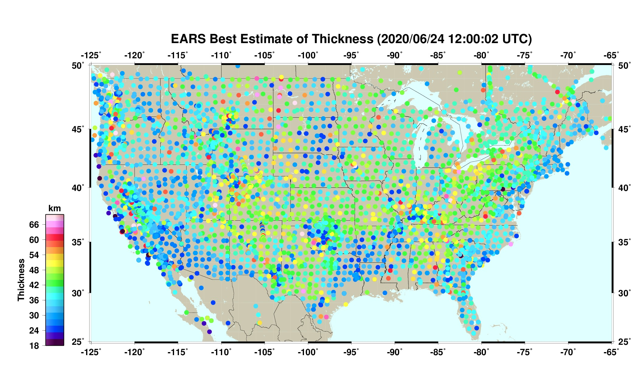
Specific application to the depth of the Moho beneath 48 states of the USA

Slide 3
The Intro

Slide 4
Distribution of points for we have data may be irregular.
What are some reasons for one or more of us wanting to grid a quantity (e.g. Moho depth) for which we have irregular measurements?
Type answer in zoom chat
Regular grid
Notes:
Examples:
To define a continuous function of the quantity of interest via evenly distributed local supports (e.g. through bilinear interpolation or splines), so we can
Average out errors in the data
Quickly estimate a value anywhere using this function
Compare the function to other known continuous quantities, e.g. topography, geologic terranes, heat flow, lithospheric thickness, density of crust and mantle, etc.
Use the function for forward computations over a whole region, e.g. the effect of the crust on surface wave propagation, or on gravity anomalies

Slide 5
Distribution of points for we have data may be irregular, have gaps,
Regular grid

Slide 6
Distribution of points for we have data may be irregular, have gaps, or have concentrations. Data may be inconsistent.
Regular grid

Slide 7
Distribution of points for we have data may be irregular, have gaps, or have concentrations. Data may be inconsistent.
Regular grid can function as a set of local supports for the data as a continuous function of position.

Slide 8
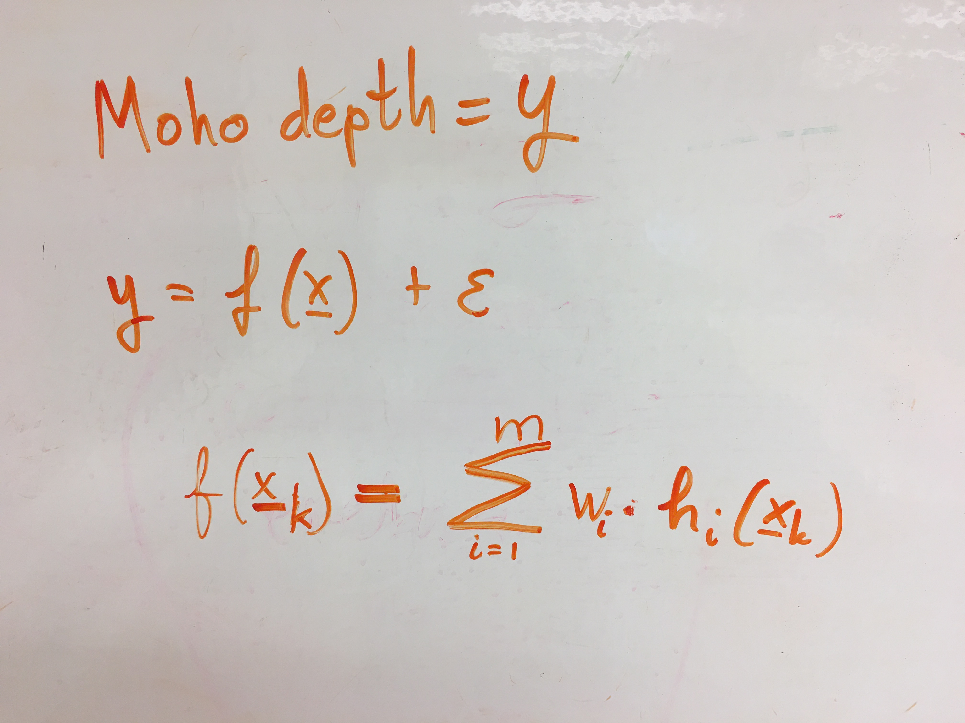

Slide 9
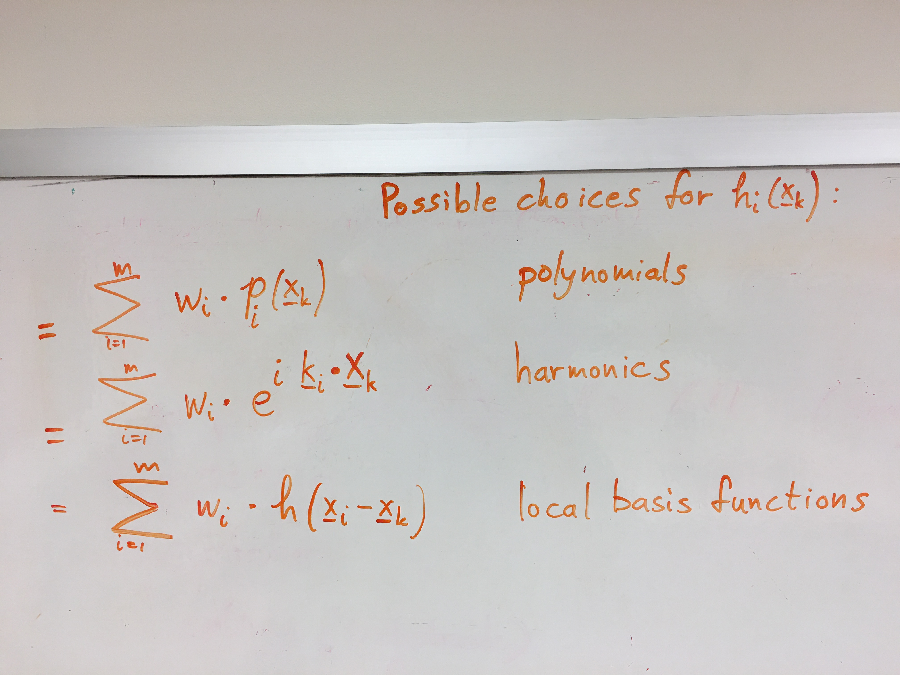

Slide 10
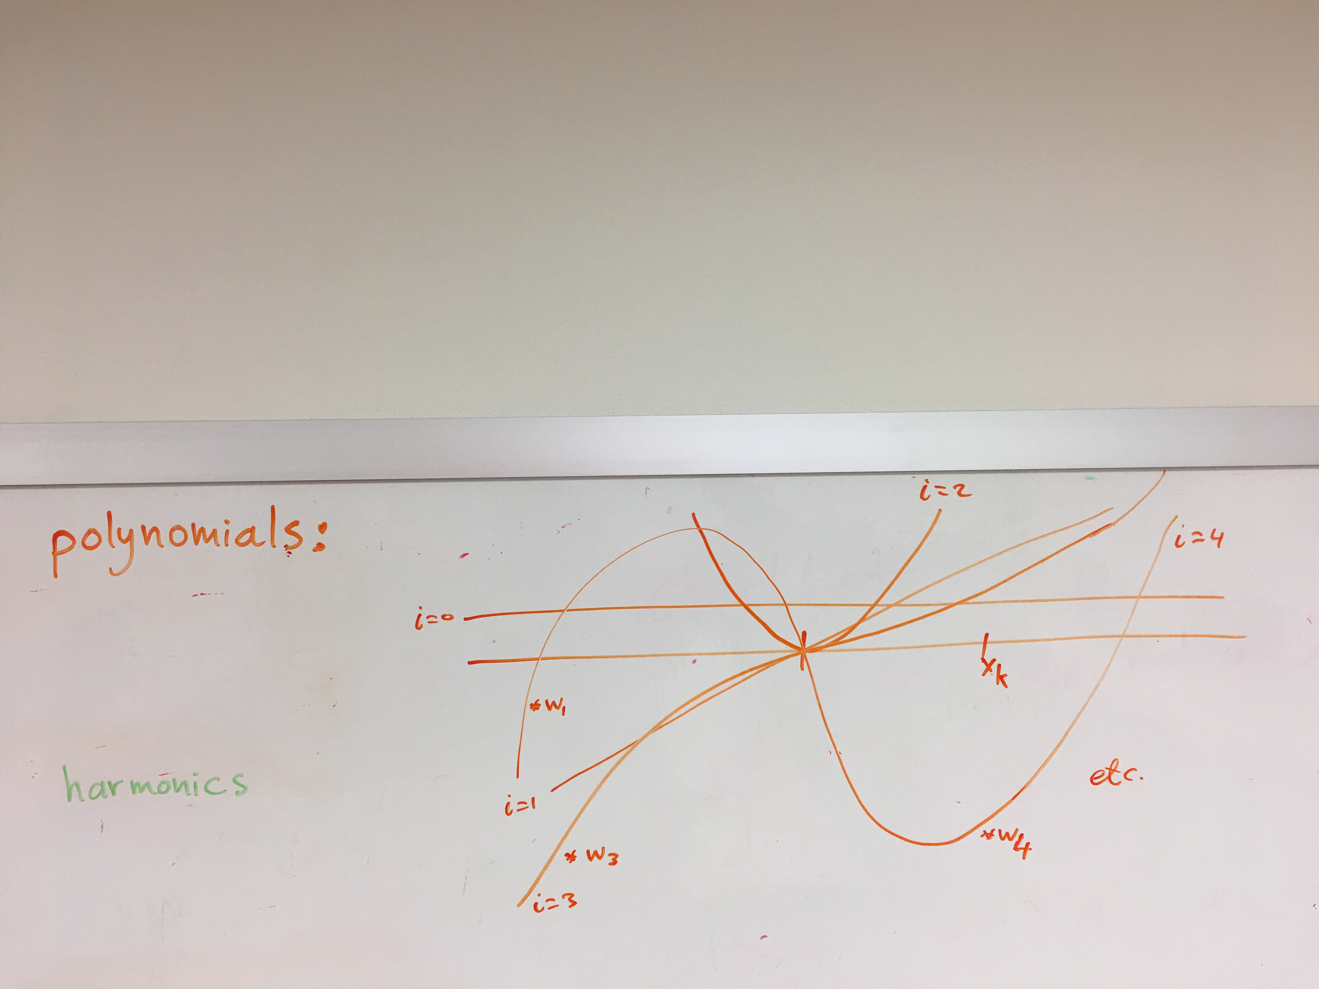

Slide 11
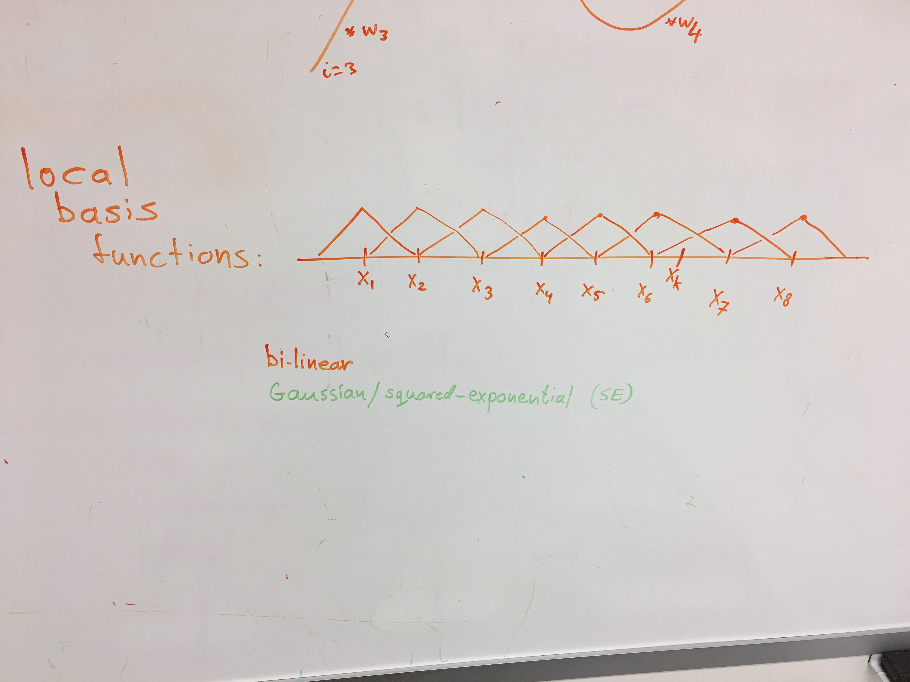

Slide 12
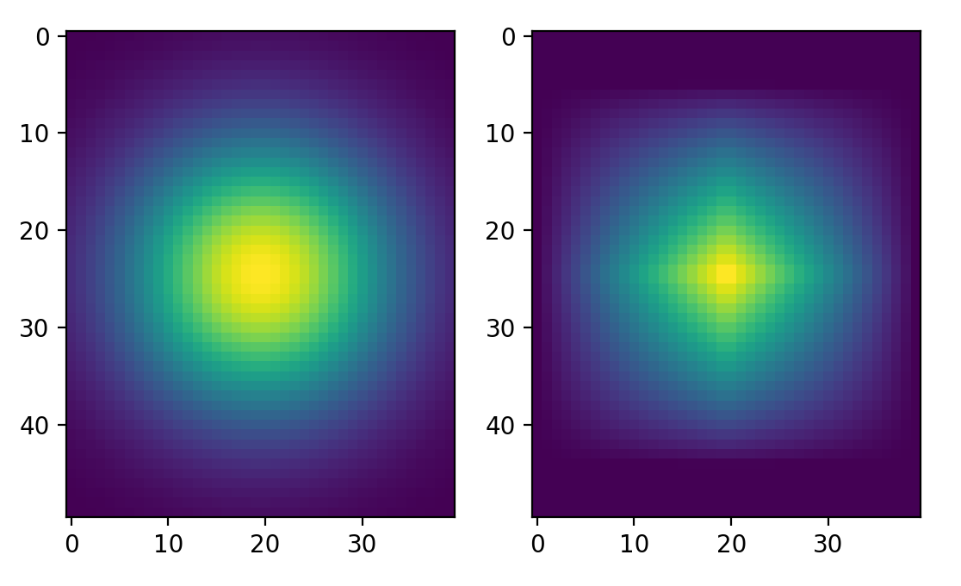
Squared Exponential
Bilinear function

Slide 13
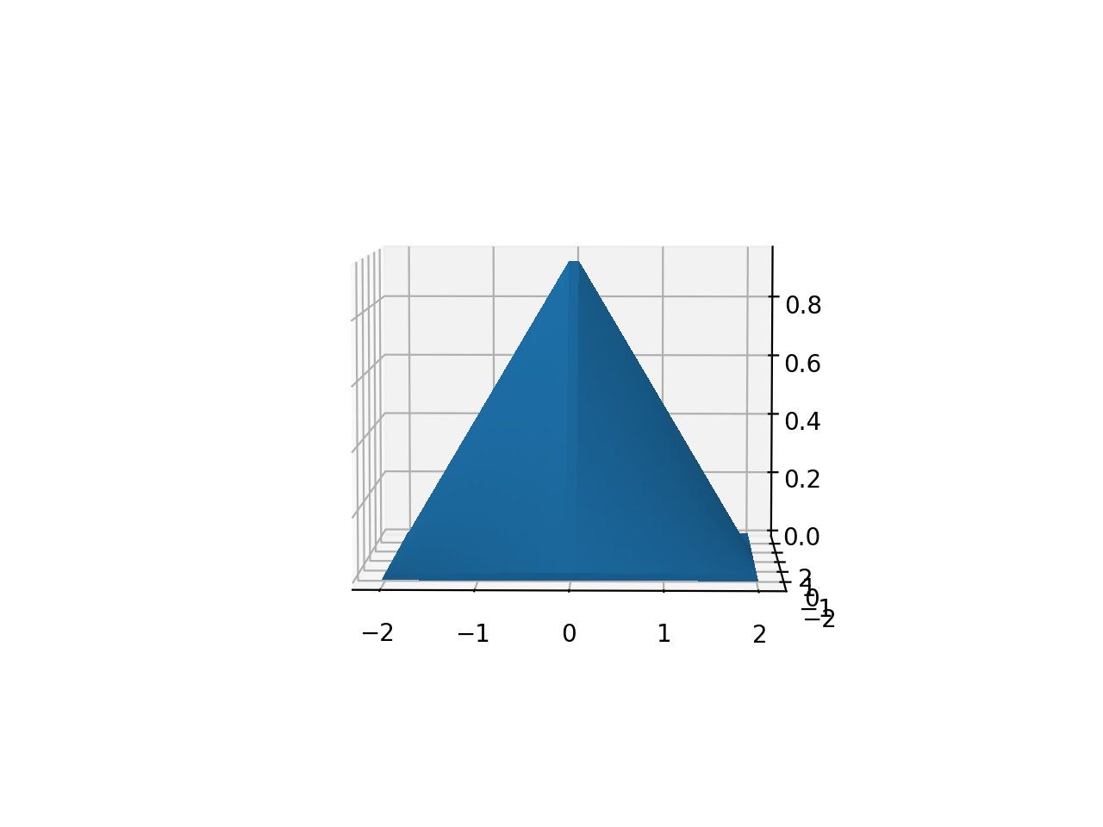
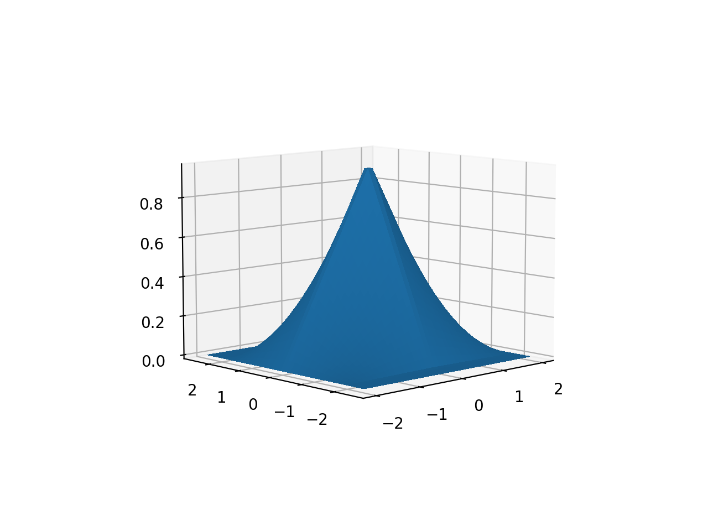
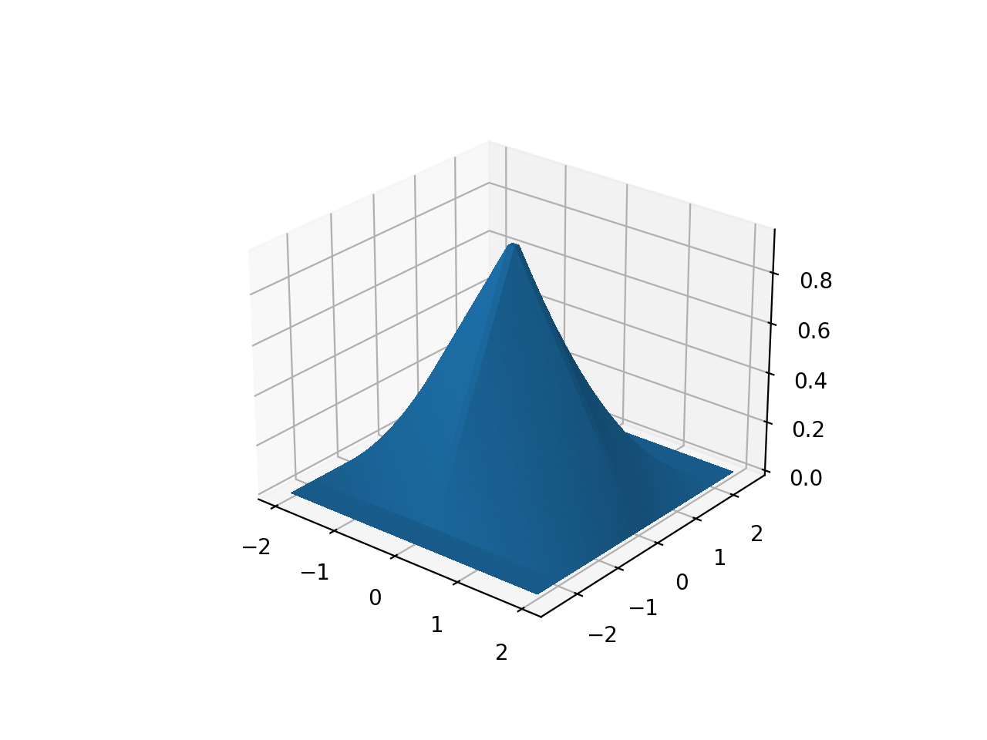
Bilinear function

Slide 14
The Maths

Slide 15
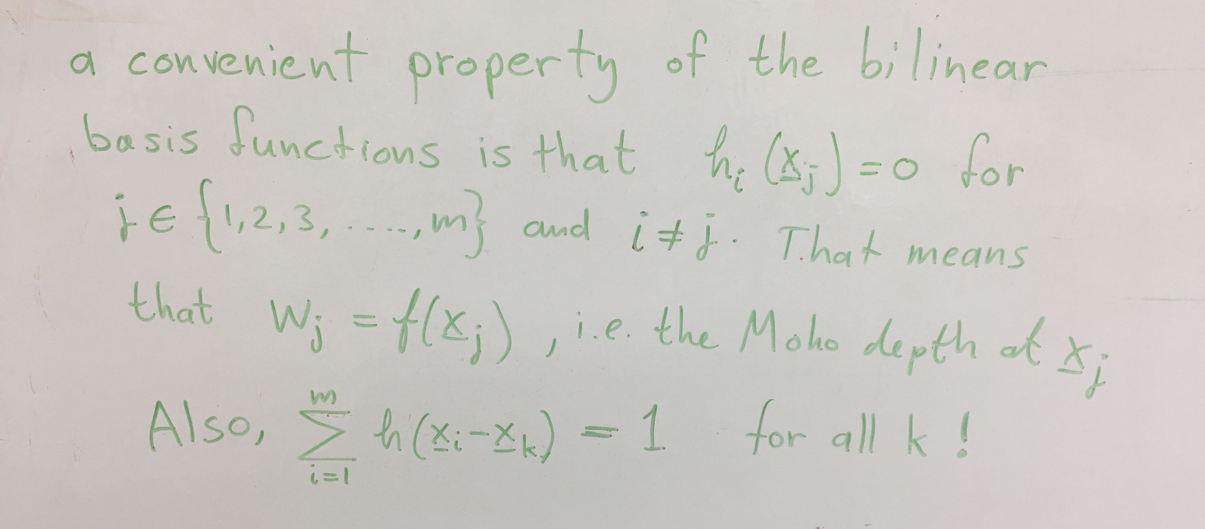

Slide 16
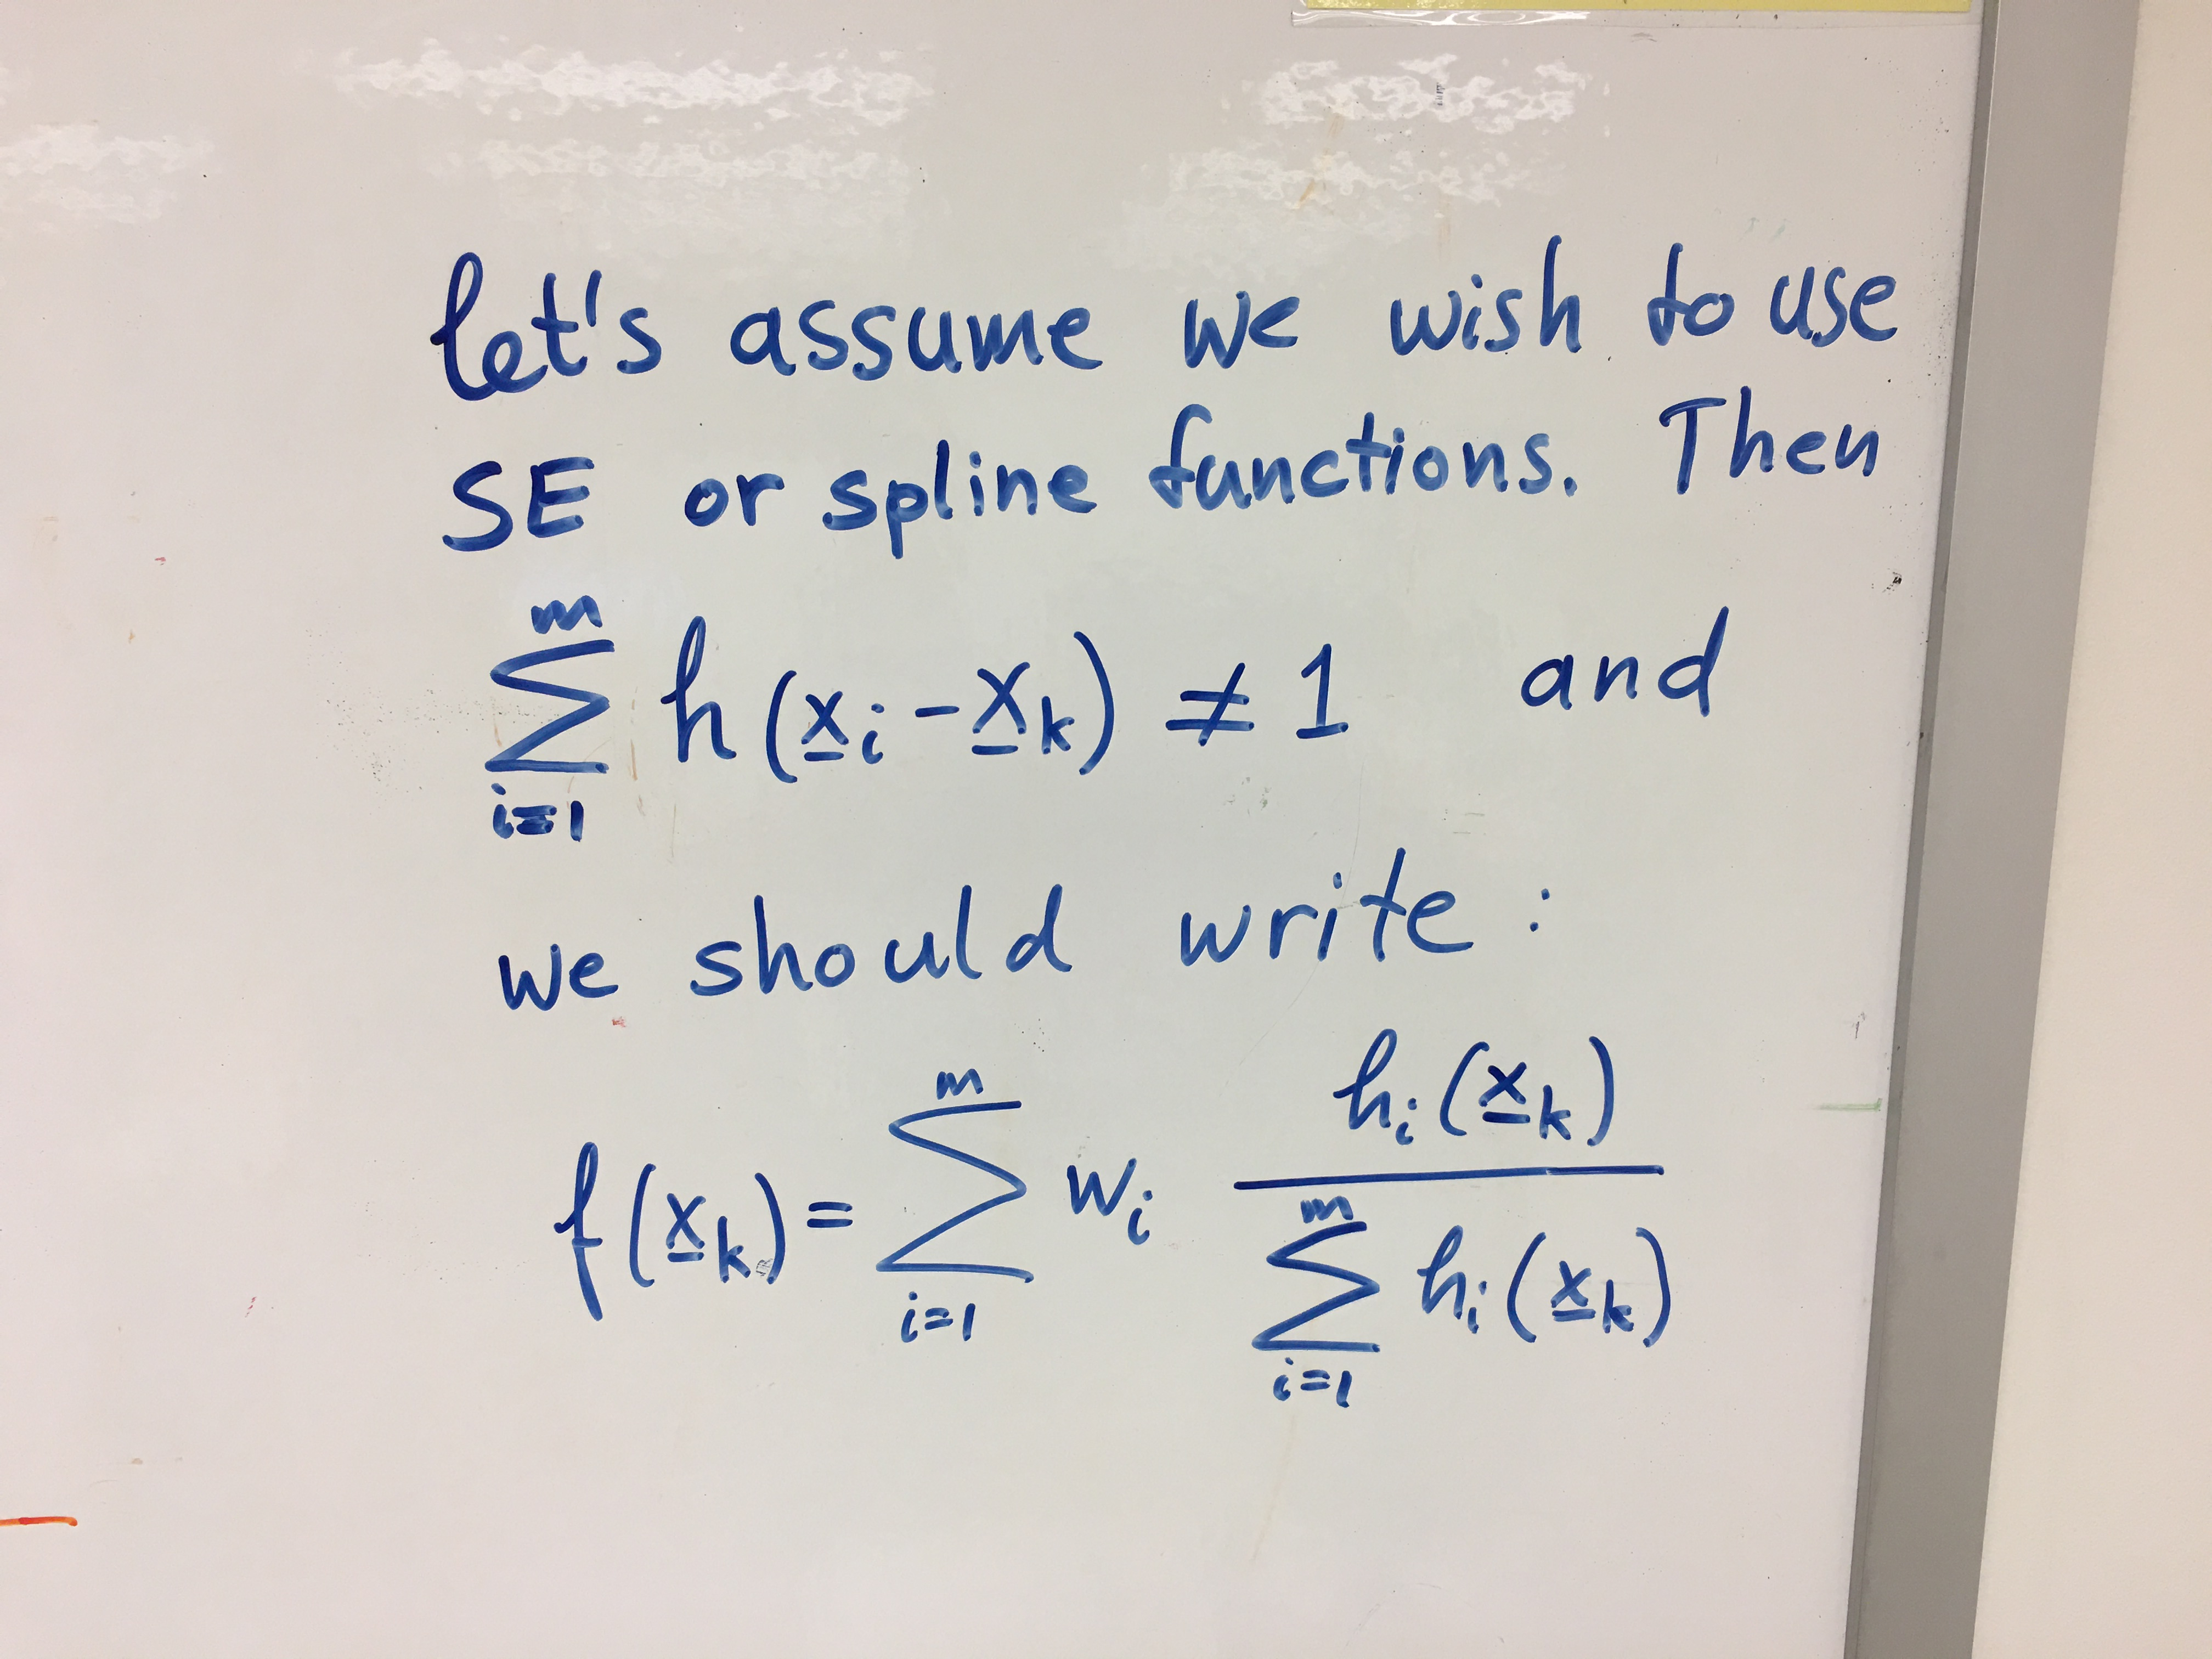

Slide 17
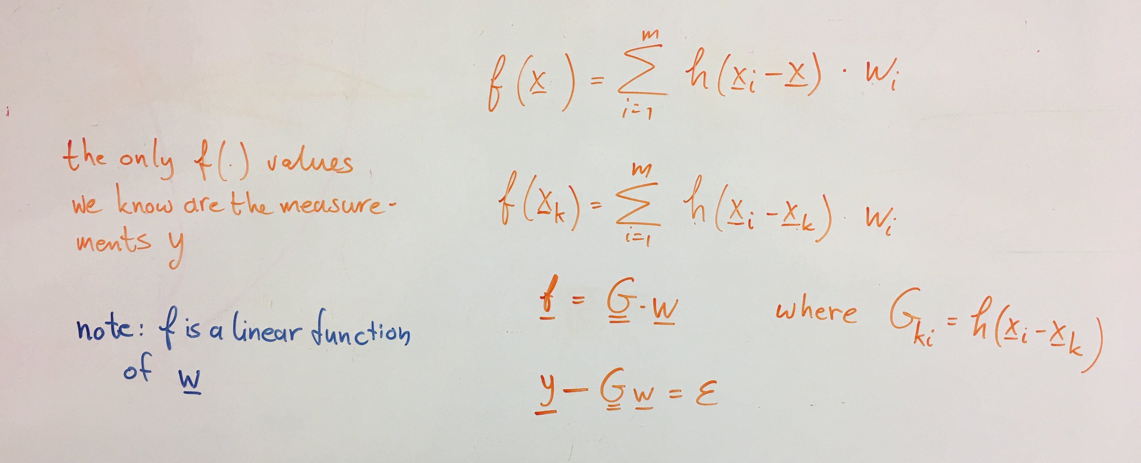

Slide 18
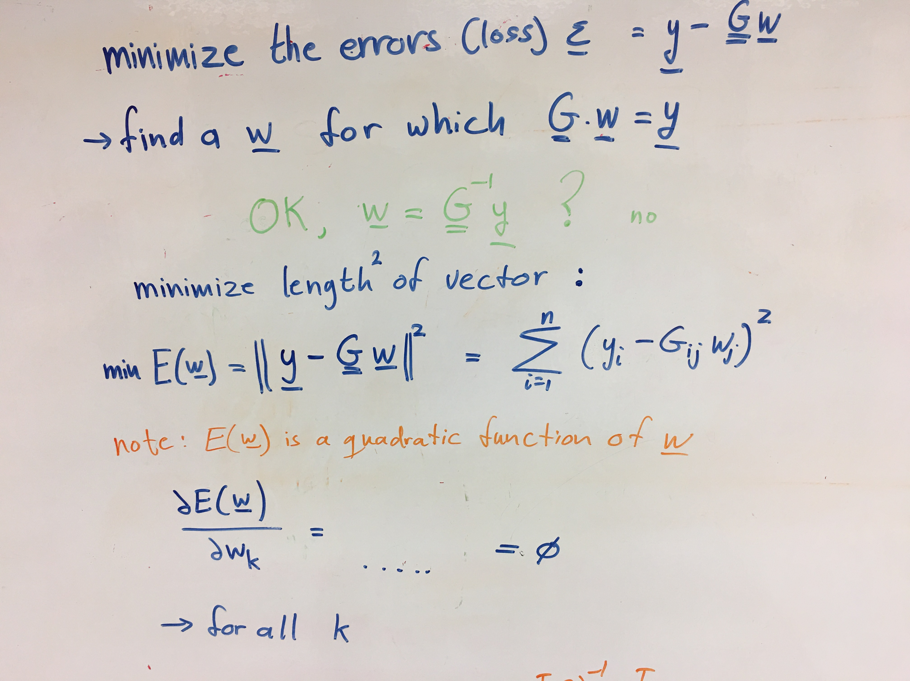

Slide 19
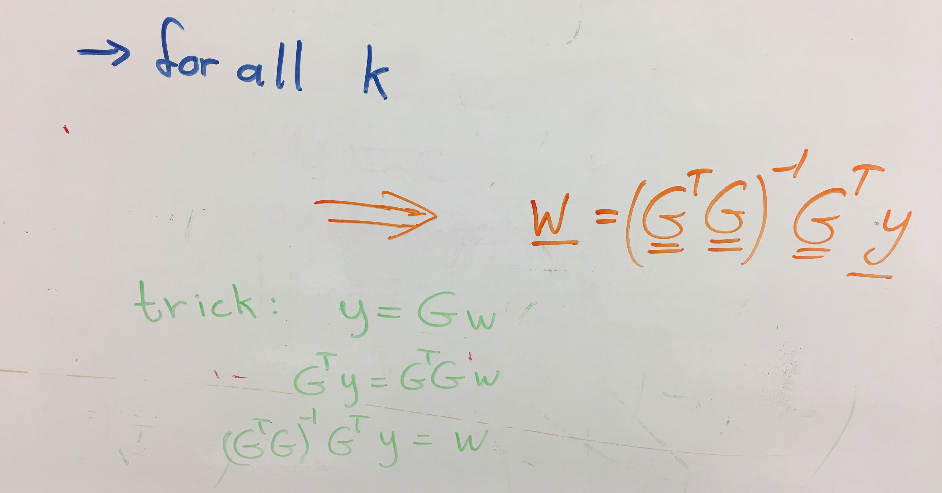

Slide 20
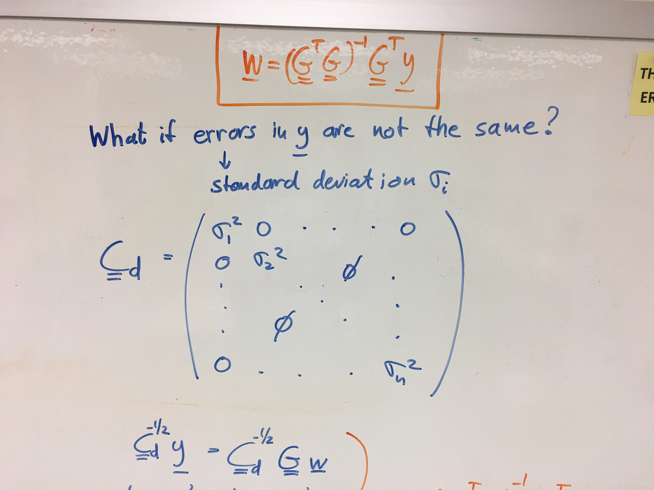

Slide 21
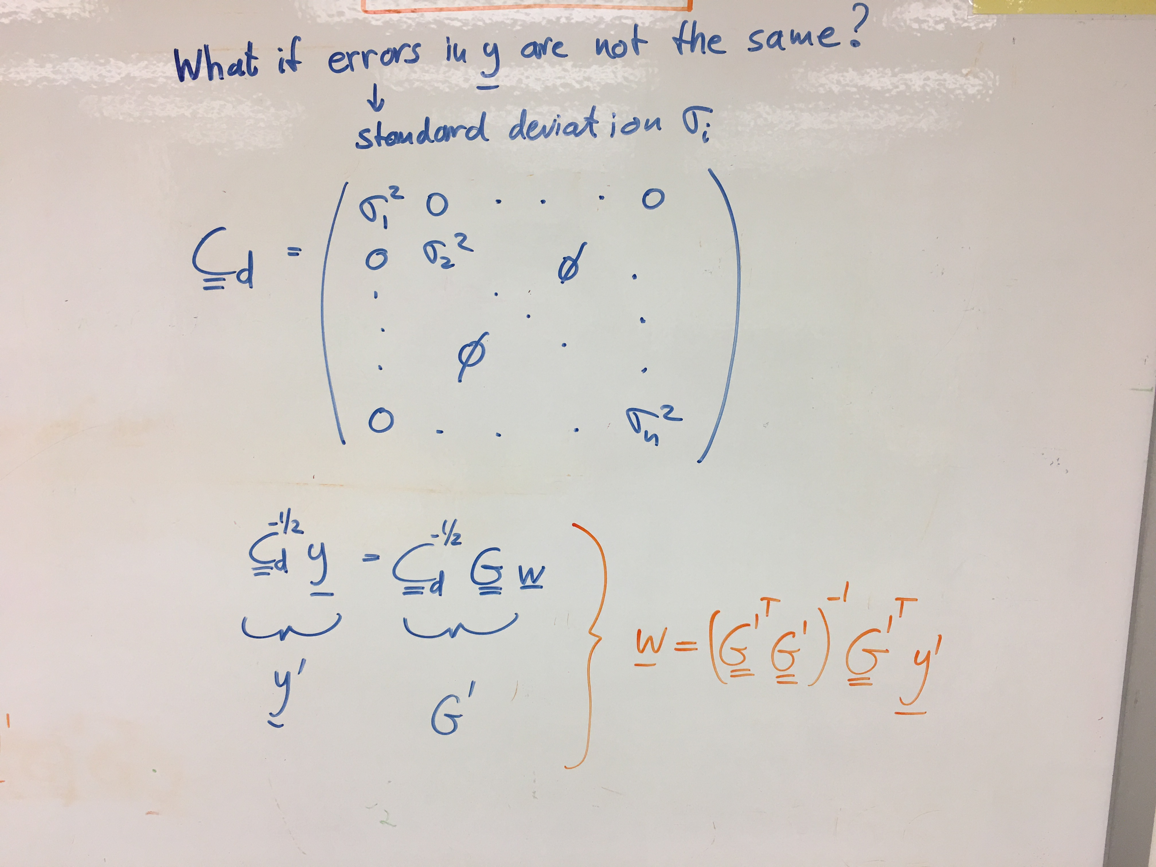

Slide 22
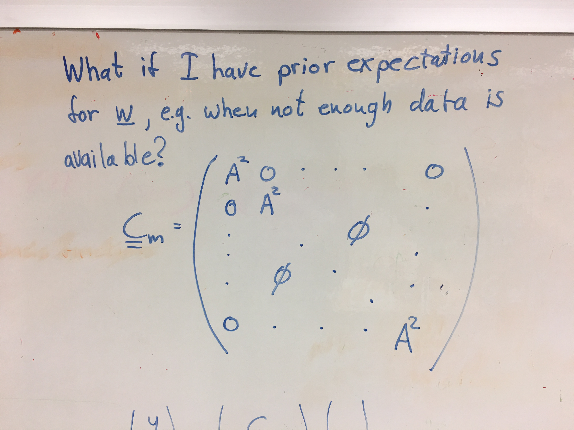

Slide 23
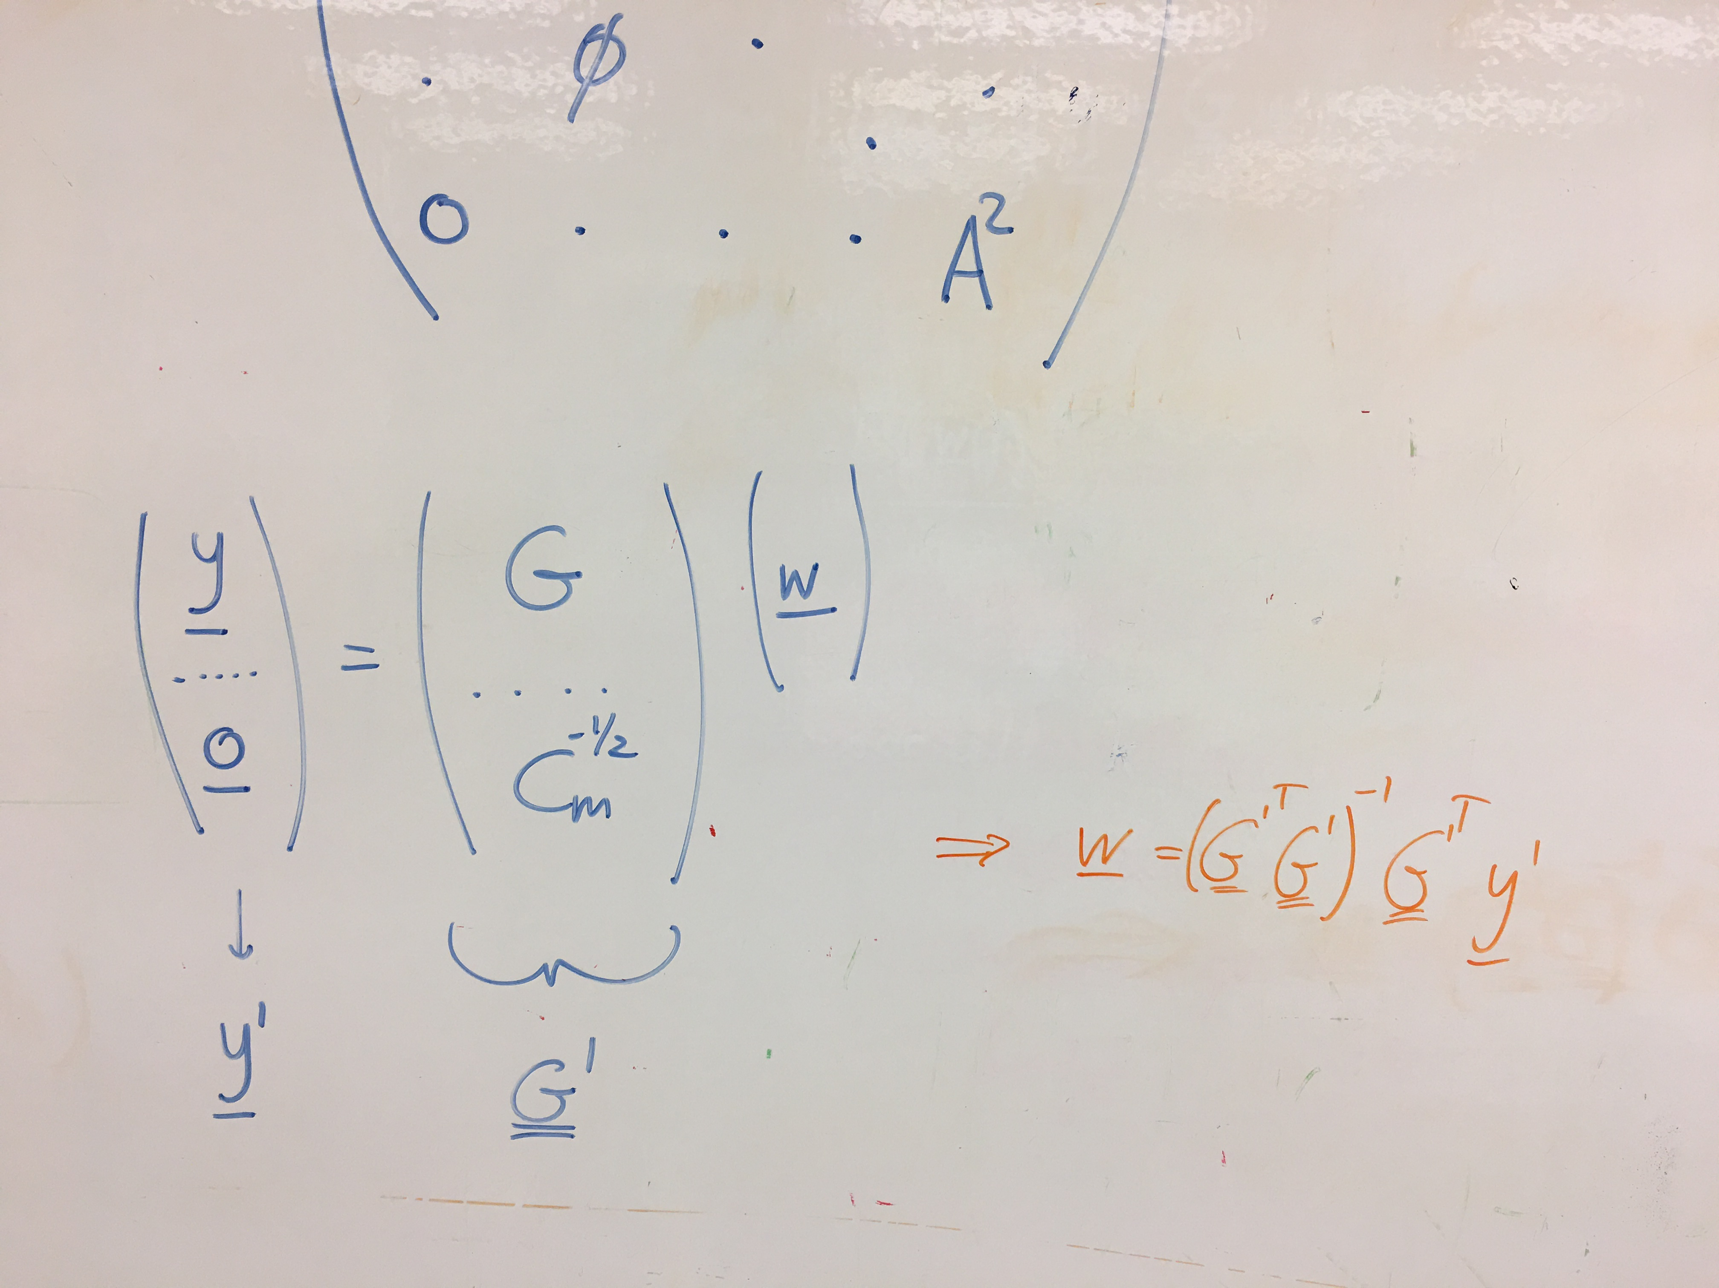

Slide 24
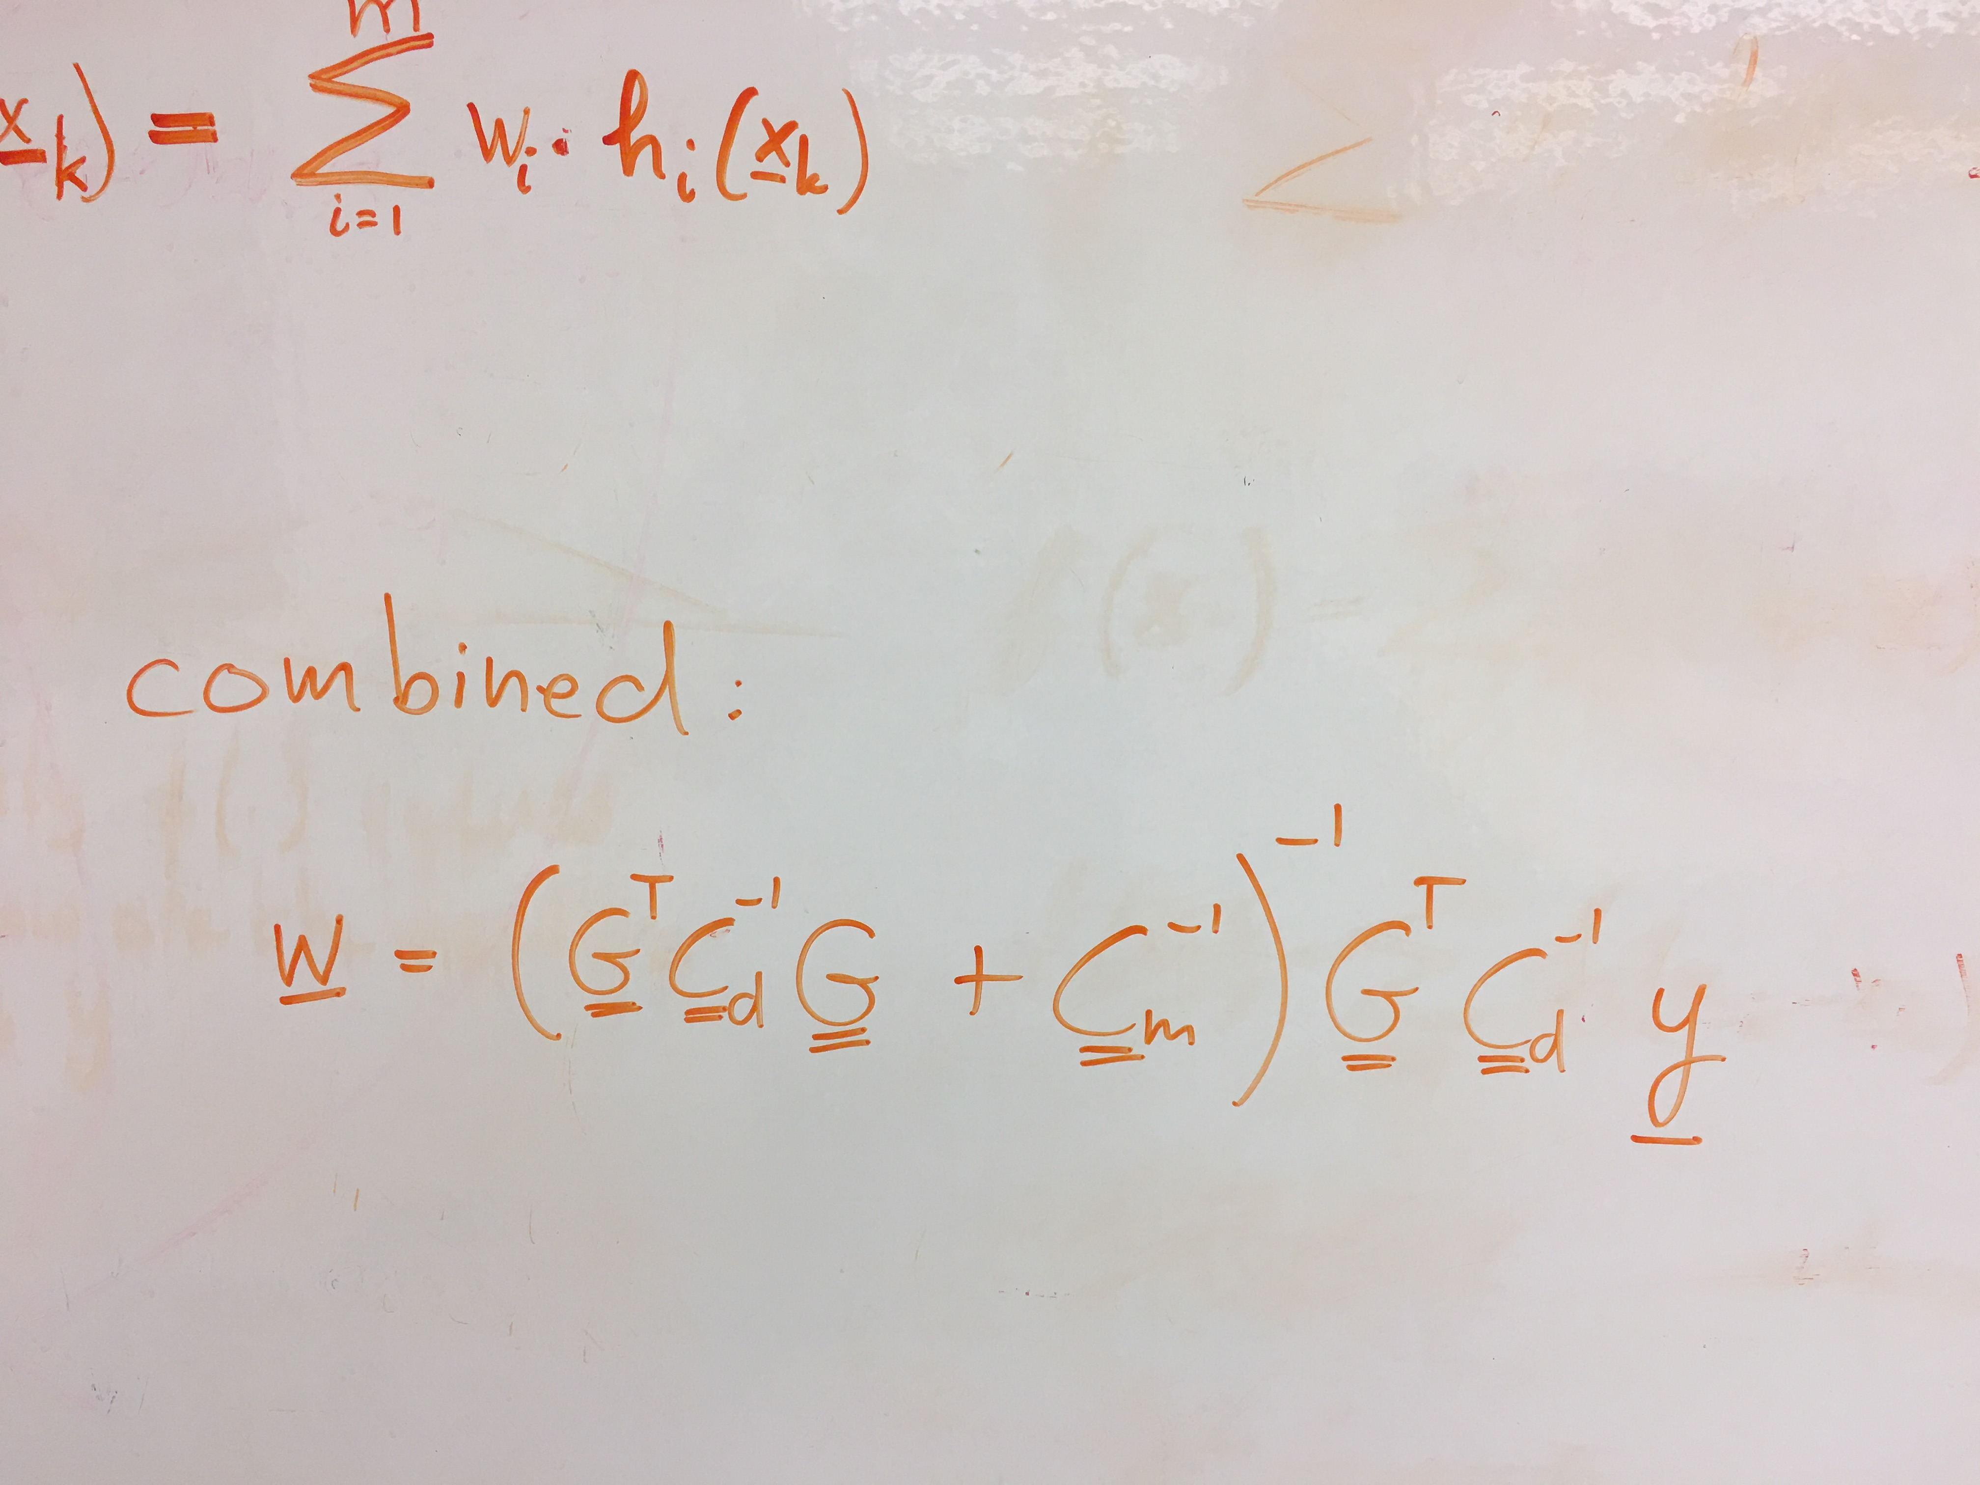
Weighting by the inverse square root of the Data Covariance matrix helps to deal with data errors that are not drawn from the same distribution (we have more precise or accurate knowledge of some Moho depths than of others).
Weighting by the inverse square root of the Model Covariance matrix helps to deal with spatial gaps in data (blank regions). Assume the simplest Moho that is consistent with prior knowledge. Damping, flattening, smoothing, …

Slide 25
The Data

Slide 26
Provided by EARS data service

Slide 27
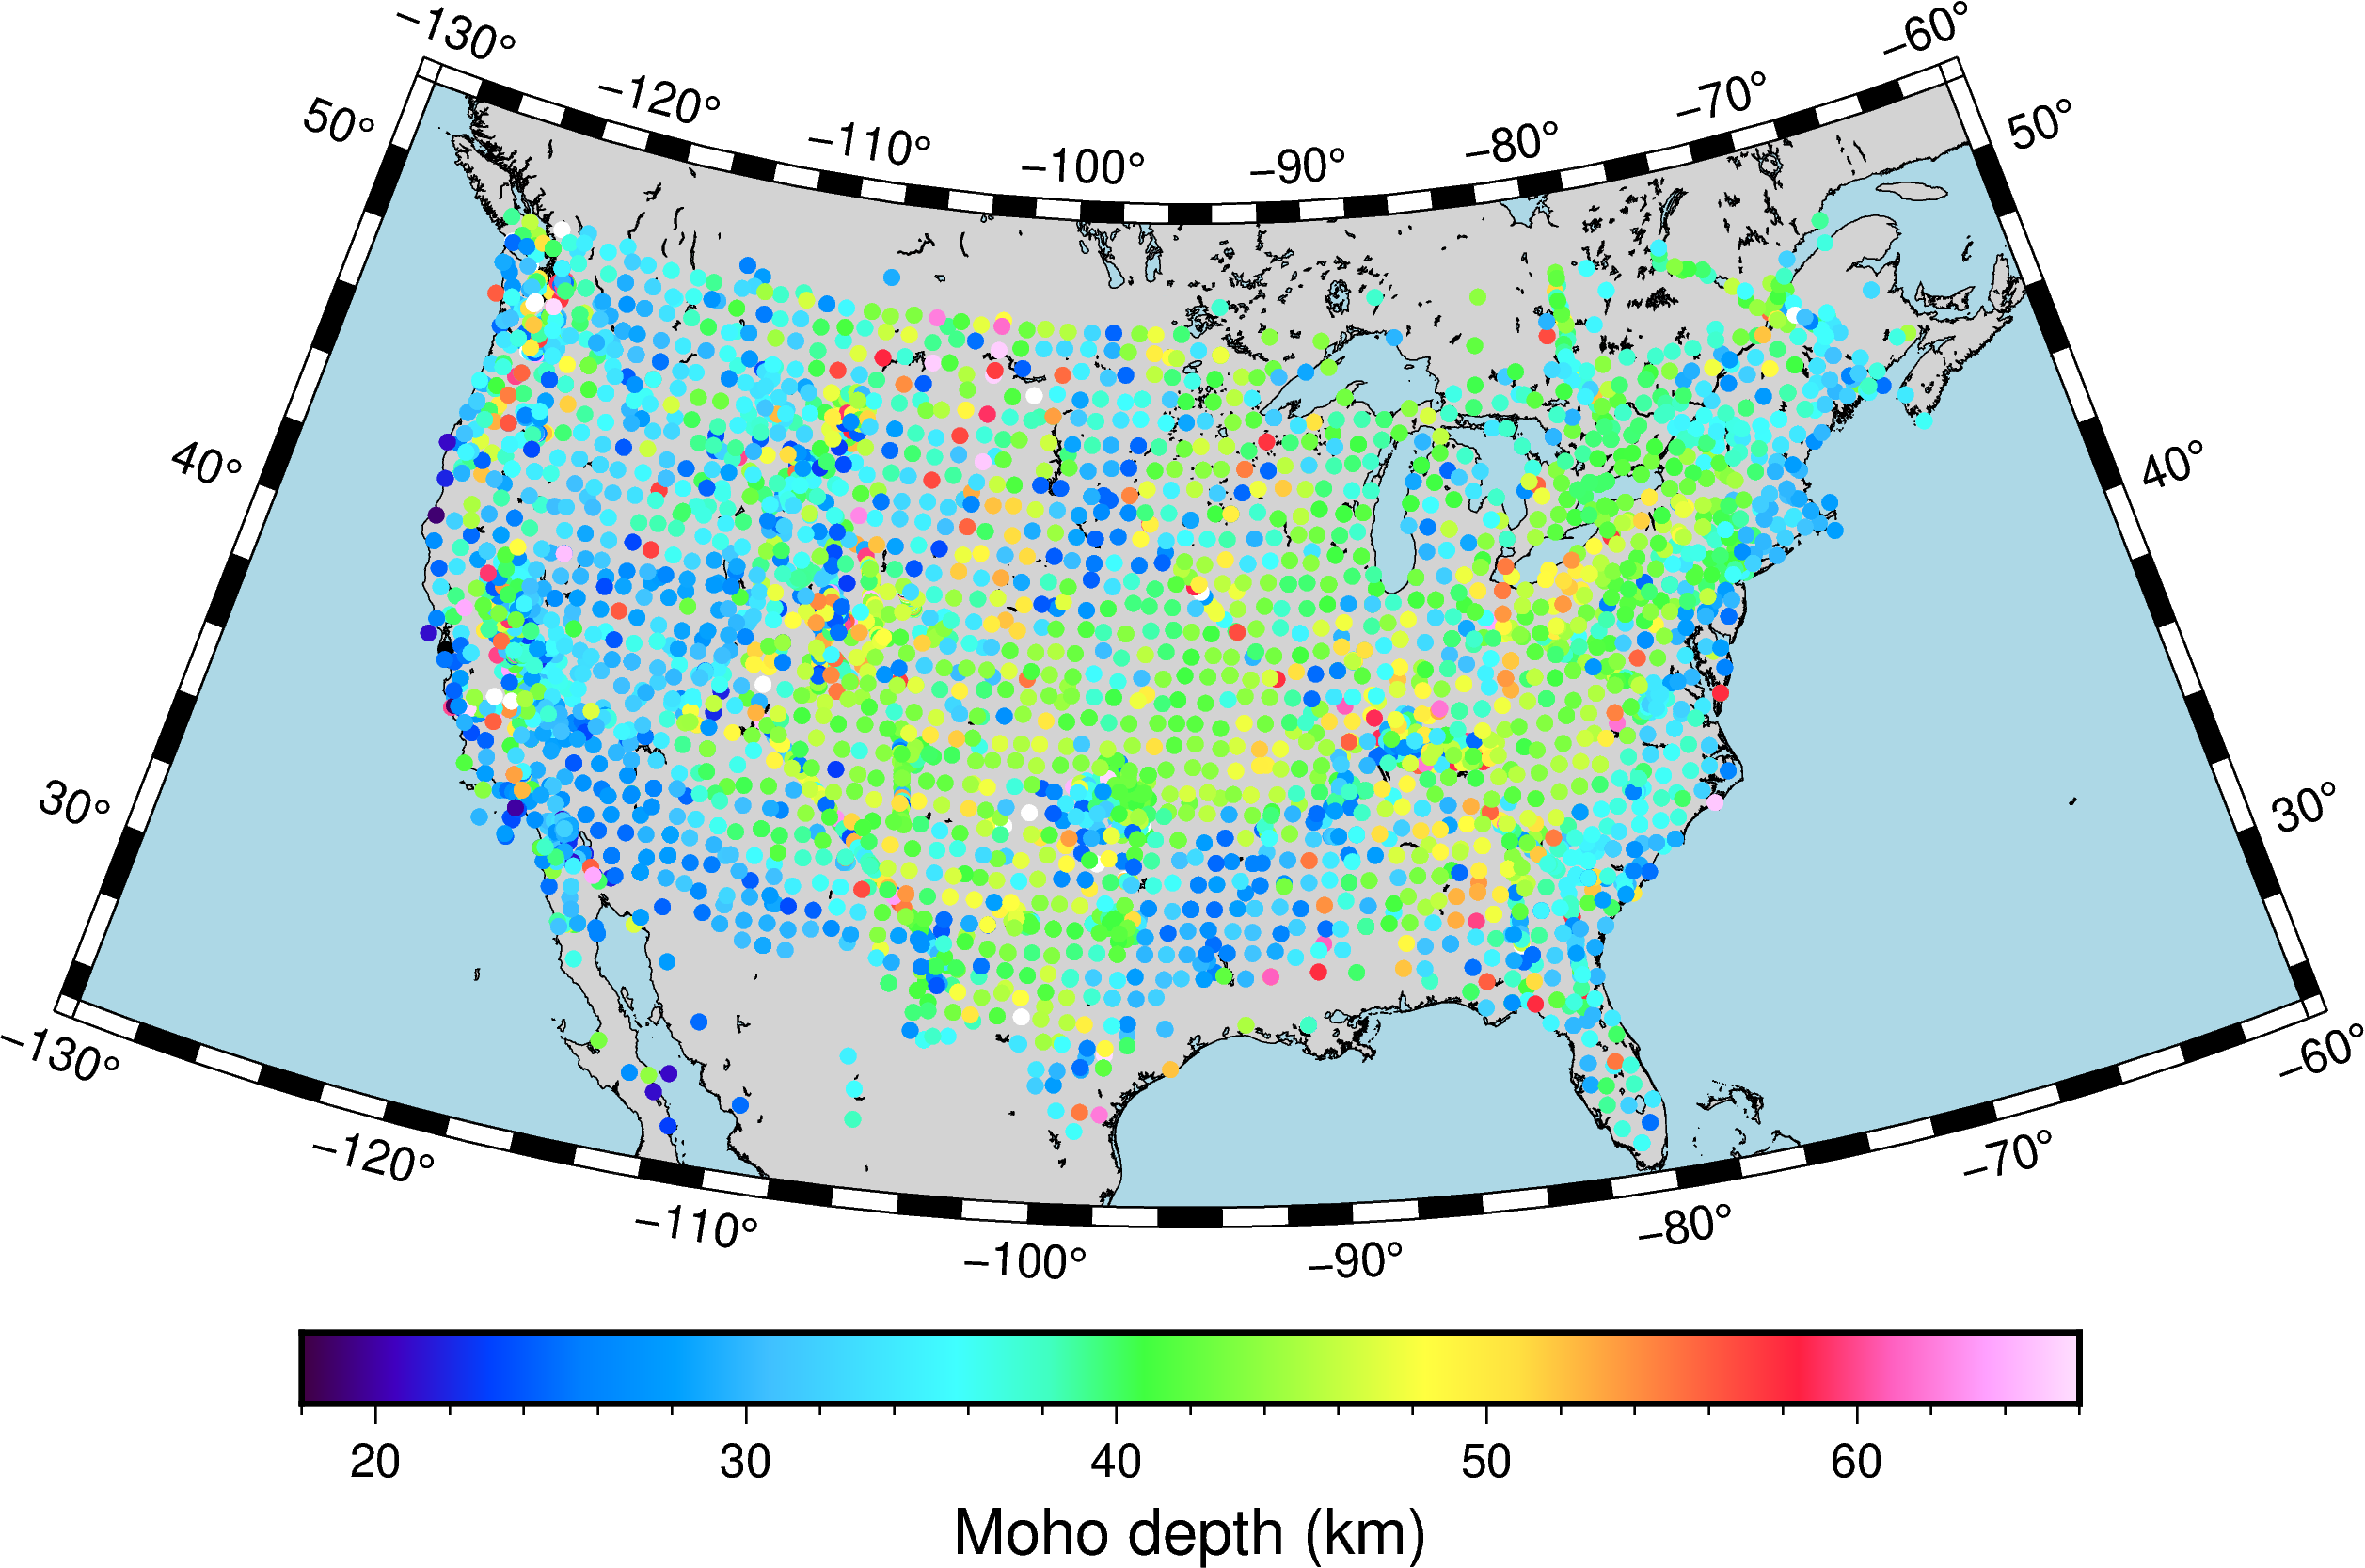
EARS downloaded at
an earlier date and
Plotted with pGMT!

Slide 28
Next: Split EARS data into estimates for USArray TA stations and non-TA stations

Slide 29
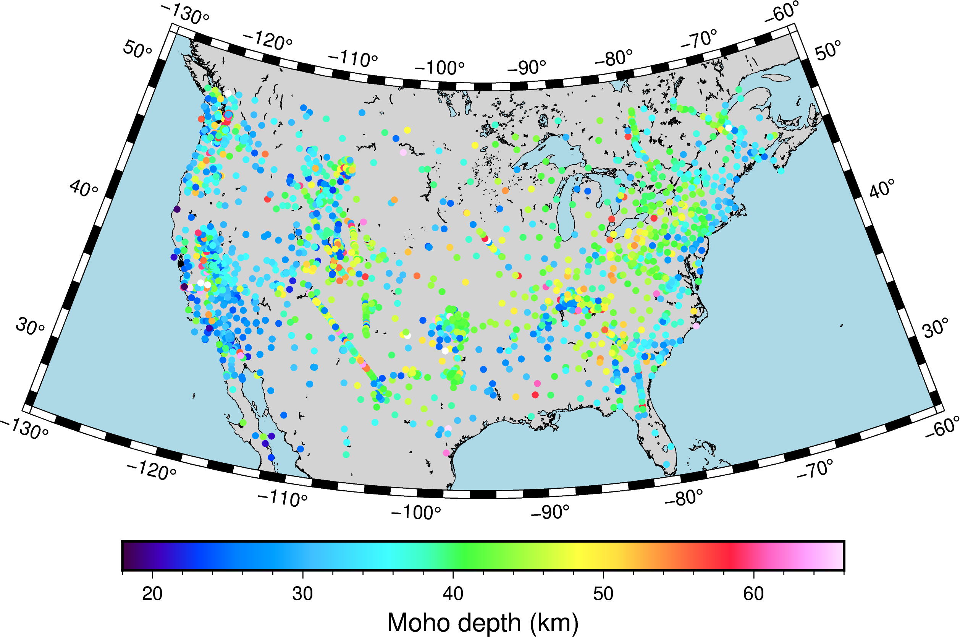
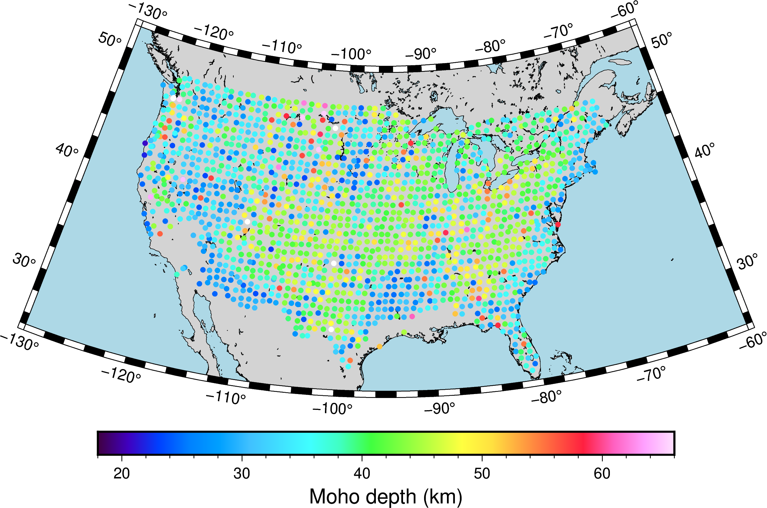
Training data
Testing data
Next: Use Moho estimates from non-TA stations to predict Moho depth at TA stations

Slide 30
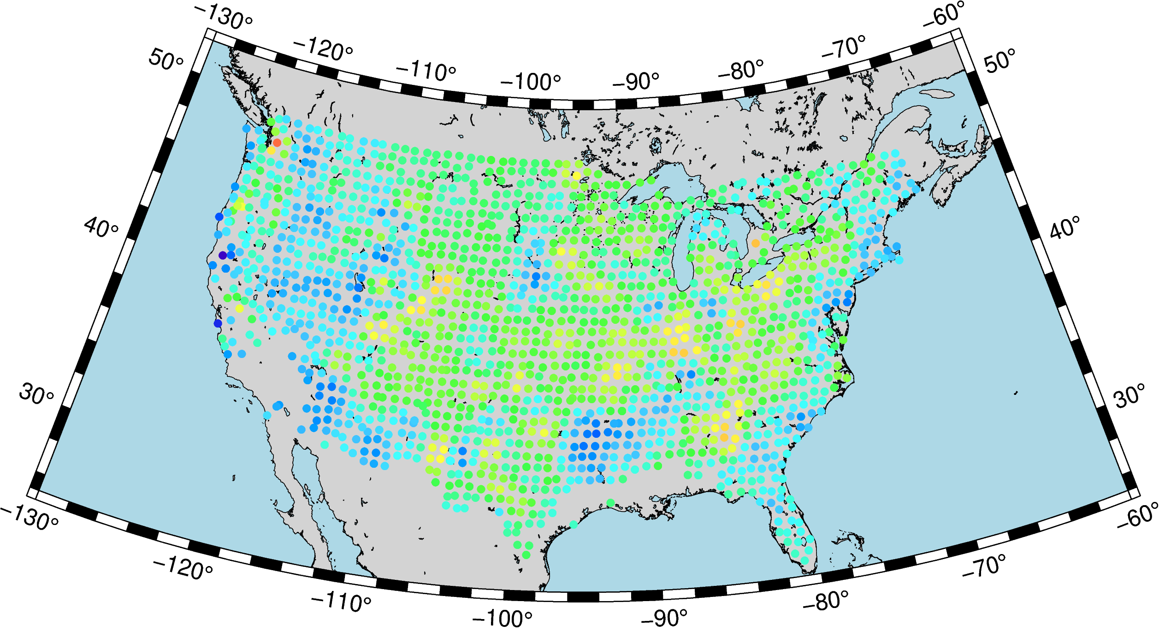
predicted data at test points
Training data
actual data at test points
Kriging
Testing data
Notes:
A=9 w=0.7

Slide 31
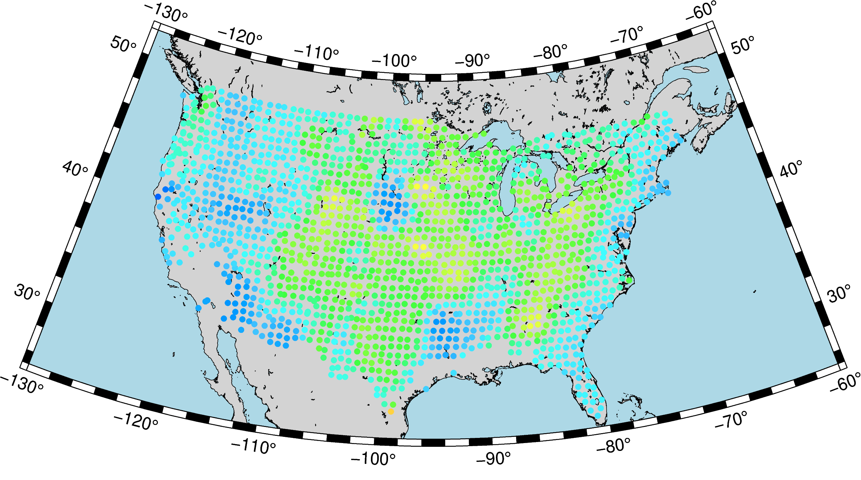
predicted data at test points
Training data
Weighted Nearest-Neighbor averaging
actual data at test points
Testing data
Notes:
W=0.7

Slide 32
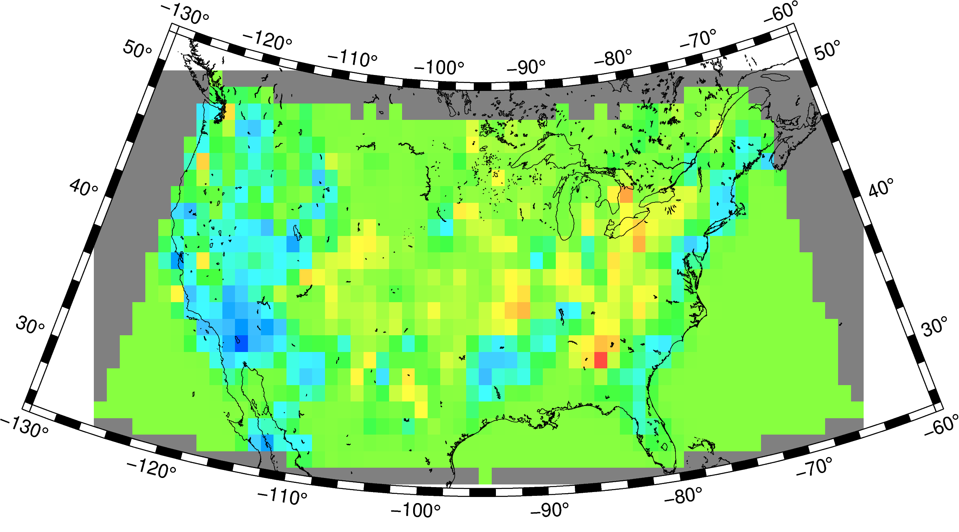
Training data
gridded
Inversion
actual data at test points
Testing data
Notes:
W=0.7

Slide 33
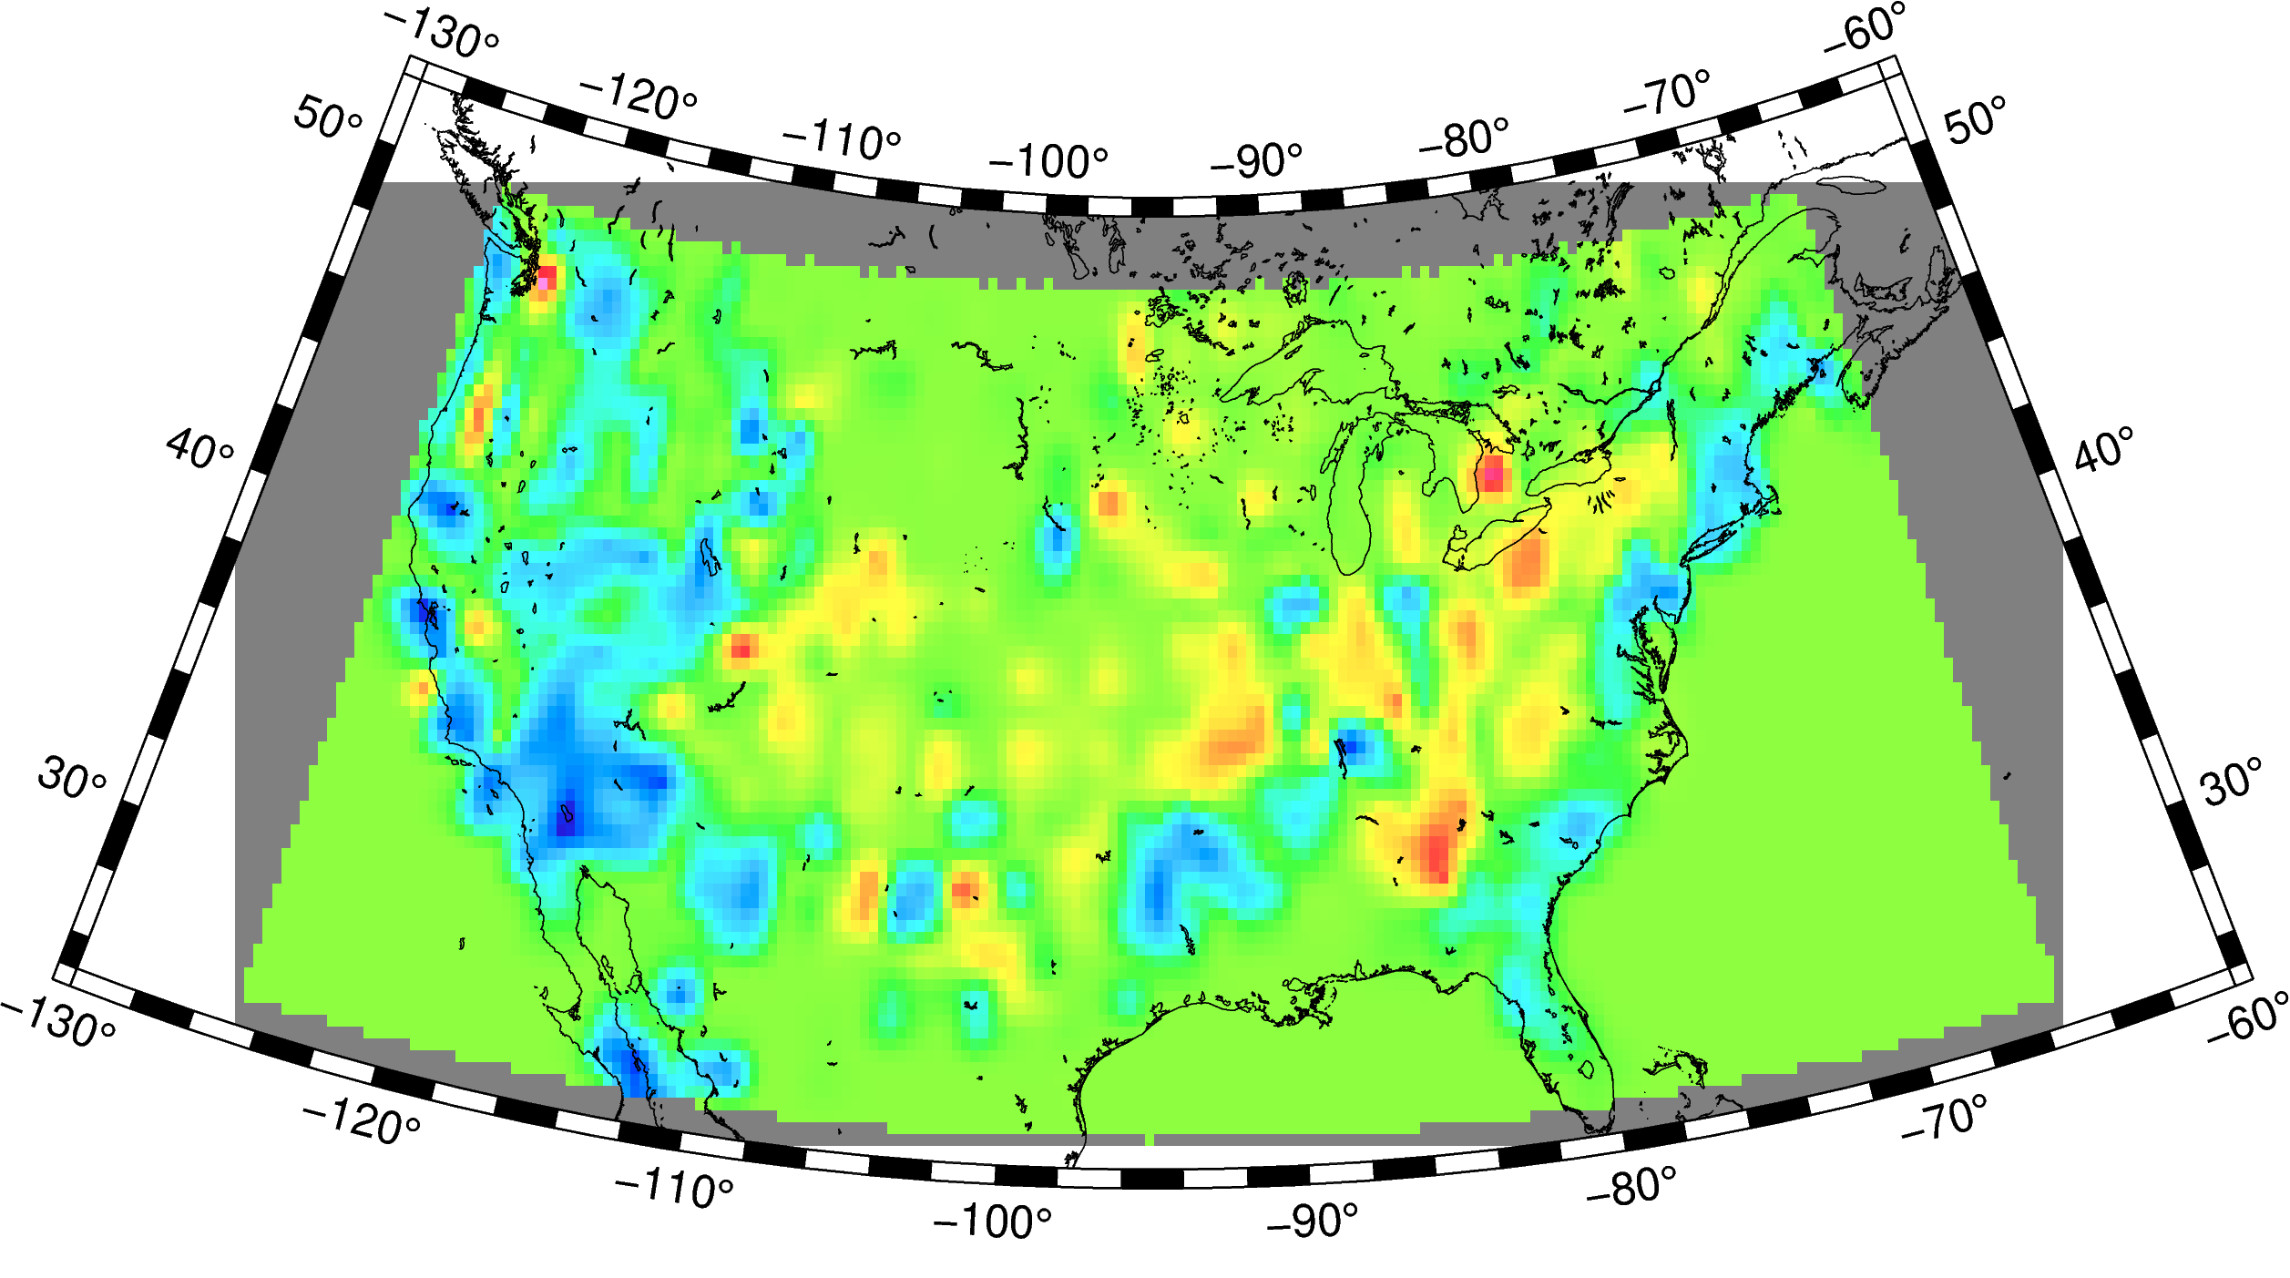
Training data
gridded
Inversion
actual data at test points
Testing data
Notes:
W=0.7

Slide 34
The Lab

Slide 35
Download EARS data
Split EARS data into estimates for USArray stations and non-TA stations
Explore different ways of using these data from non-TA stations to predict Moho depths at TA stations:
Without gridding (weighted nearest neighbors, kriging)
With gridding (using 1x1 grid and bilinear basis functions)
Detail on point b (gridding):
Define bilinear basis functions – example on 1x1 grid.
Use non-TA data on Moho depth and their error estimates, and prior expectations to infer optimal weights w (which themselves are Moho depths at the support points of the regular grid!) → this is called inversion
Use w to predict the Moho for TA stations
Calculate fit.
More details in Lab Notebook
QUESTIONS?

